Slide 1
MATH QUIZ

Slide 2
ROUND -1

Slide 3
Question -1)
How many squares are there in this picture ?
CORRECT ANSWER : 14 SQUARES !

Slide 4
Question -2)
Ramu put a square fence around his vegetable garden to keep the deer away from eating his corn . One side was 10 m in length .If the posts were placed 2 m apart , then how many posts did he use ?

Slide 5
ANSWER : 20 posts !

Slide 6
Question -3)
Use the following operations (+,-,x,/) and numbers
( 1 , 7 , 7 , 7 , 7 ) to make the number 100 .
CORRECT ANSWER :
177 – 77 = 100

Slide 7
Question -4)
You know 2 + 2 comes to the same as 2 x 2. Now find a set of three different whole numbers whose sum is equal to their product when multiplied
CORRECT ANSWER :
1x2x3 = 6
1+2+3 = 6

Slide 8
Question -5)
What is the smallest natural number that is equal to seven times the sum of its digits?
CORRECT ANSWER : 21

Slide 9
QUESTION 6)
An athlete is able to jump FOREVER. However, every time she jumps (Long Jump) she gets a bit more tired, and every jump goes 1/2 as far as her prior jump. Now, for her very first jump, she goes 1/2 of a foot. On her second jump, she goes ¼ of a foot, and so on and so forth. How many jumps does it take for her to travel 1 foot?

Slide 10
ANSWER : The athlete can never reach 1 foot

Slide 11
QUESTION 7)
Can you fill the blank space:
19=8 6=3
70=7 8=5
60=5 15=7
16=? 17=?
ANS:
16 = 7 and 17 = 9 because the number of letters in the spelling sixteen is 7 and those of seventeen is 9.

Slide 12
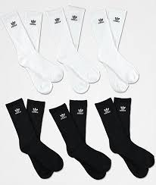
Question 8)
You have 10 black socks and 10 white socks mixed up in a drawer. You’re up very early and it’s too dark to tell them apart. What’s the smallest number of socks you need to take out (blindly) to be sure of having a matching pair?
ANS : 3 socks

Slide 13
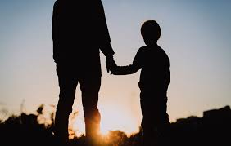
QUESTION 9)
When my father was 31 I was 8. Now he is twice as old as me. How old am I?
I am 23 years now !

Slide 14
Question 10)
FIND THE NEXT NUMBER IN THE SEQUENCE : -
1 , 2 , 17 , 82 , ____

Slide 15
ROUND-2

Slide 16
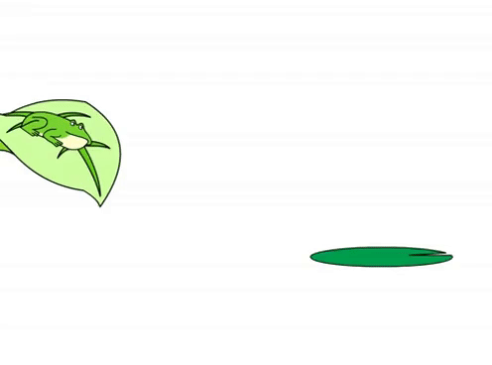
Question 11)
A frog fell into a hole that was 14½ feet deep. He could jump 3 feet, but he slid back a foot each time he jumped. How many jumps does it take him to get out of the hole?

Slide 17
ANSWER :
7 jumps , Every 3 Feet Jump Accompanied By A 1 Foot Slide Equals 2 Feet High Jumps Each; At This Rate, So The 7th Jump, Starting At 12 Feet, Brings Him To 15 Feet, Which Takes Him Out Of The Hole.

Slide 18
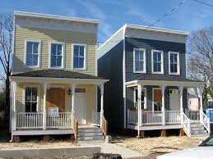
QUESTION 12)
My twin lives at the reverse of my house number. The difference between our house numbers ends in two. What are the lowest possible numbers of our house?

Slide 19
ANSWER:
The lowest possible numbers for our house are
19 and 91
91 – 19 = 72 , ends in 2 !

Slide 20
QUESTION 13)
Santa was copying down his Mathematics Homework the other day, but because he was in a hurry he copied it down incorrectly. They had been learning about multiplication and had five of them to do at home . Santa, however, copied every number down backwards:
Instead of writing 14 x 82, Santa wrote 41 x 28
Instead of writing 13 x 62, Santa wrote 31 x 26
Fortunately for Santa all his answers were still correct!
What were the other three questions?

Slide 21
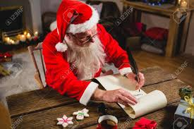
Answer: So the other three questions were 12 x 42, 12 x 84 and 12 x 63

Slide 22
Question 14)
In the equation shown, P, Q, R, S, and T are 5 consecutive positive integers. What are they?
P² + Q² + R² = S² + T²
Ans :
Squares of 5 consecutive integers
P=10, Q=11, R=12, S=13, T=14
i.e. 10x10 + 11x11 + 12x12 = 13x13 + 14x14

Slide 23
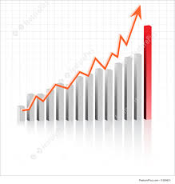
QUESTION 15)
The price of a commodity increases by 25% every odd year and reduces by 20% every even year. By how much percentage, the prices would have risen or fallen after exactly 8 years?

Slide 24
ANSWER :
Let the price at the beginning of the year is 100.
There will be four pairs of multiplication with 5/4 and 4/5.
Thus, it will remain unchanged. So there will be no change after 8 years

Slide 25
QUESTION 16)
I am a college student . The ages of my father and me add up to 66. My father’s age is my age reversed.
How old could my father be?
My age : 24
My fathers age :- 42

Slide 26
QUESTION 17)
The total cost for a new pair of headphones and a new pair of sunglasses is $140. The headphones cost $100 more than the sunglasses. How much do the headphones cost?
ANSWER :- $120 , $20

Slide 27
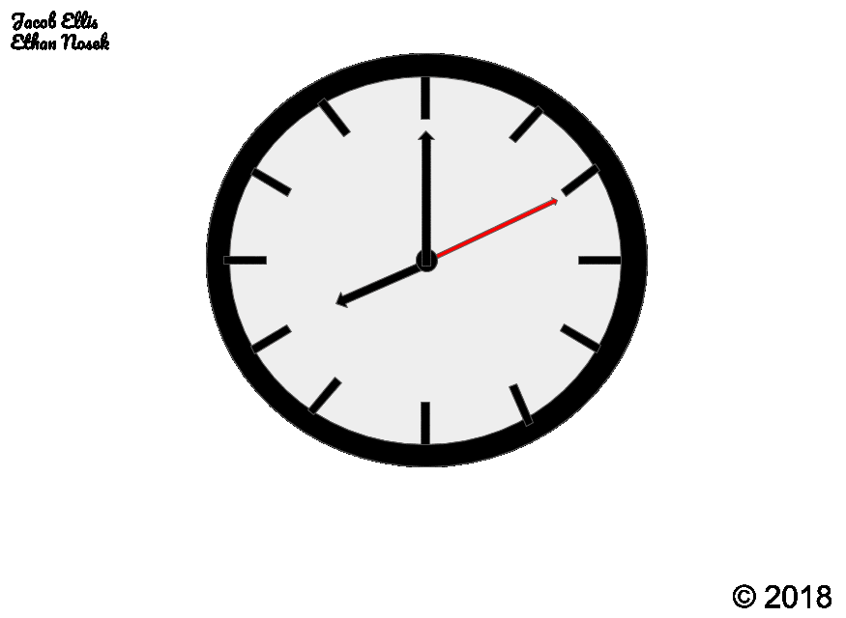
QUESTION 18)
At 8 AM, a clock ticks 8 times. The time between first and last ticks is 35 seconds. How long does it tick at 11 Noon

Slide 28
ANSWER :
It is given that the time between first and last ticks at 8'o clock is 35 seconds.
Total time gaps between first and last ticks at 8'o clock= 7
(i.e. between 1 & 2, 2 & 3, 3 & 4, 4 & 5 and 5 & 6, 6 & 7,7 & 8)
So time gap between two ticks = 35/7 =5 seconds.
Now, total time gaps between first and last ticks at 11'o clock = 10
Therefore time taken for 11 ticks = 10 * 5 =
50 seconds .

Slide 29
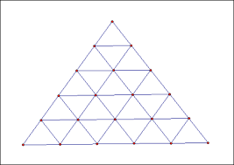
QUESTION 19)
How many triangles are there in the given figure:

Slide 30
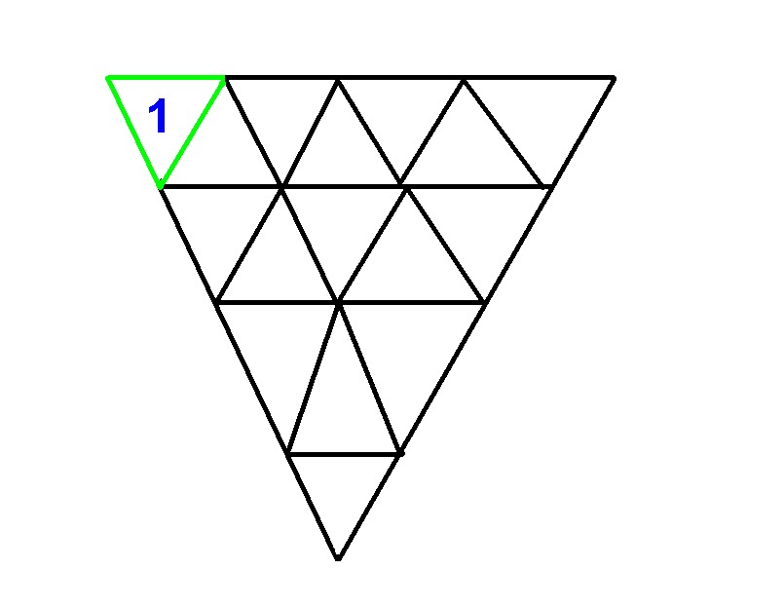
ANSWER : 27

Slide 31
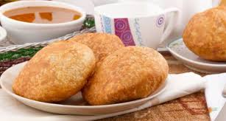
QUESTION 20)
Sami decided to give Kachoris to her friends on her Birthday. If she gives 3 Kachoris to each friend, one friend will get only 1 Kachoris. Also, if she gives 2 Kachoris to each friends, she will be left with 13 Kachoris. How many Kachoris Sami got on her Birthday? And how many friends are there?

Slide 32
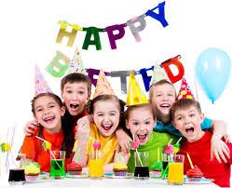
ANSWER : 15 friends , 43 kichoris

Slide 33
ROUND -3
VISUAL ROUND

Slide 34
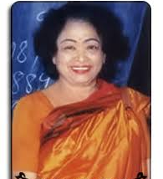
IDENTIFY THE PERSON

Slide 35
Answer :
Shakuntala devi
Her contributions towards mathematics :
Shakuntala Devi was an Indian writer and mental calculator, popularly known as the "human computer". Her talent earned her a place in the 1982 edition of The Guinness Book of World Records.

Slide 36
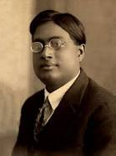
IDENTIFY THE PERSON

Slide 37
Answer :
Satyendranath
Bose
About him:
Satyendra Nath Bose, FRS was an Indian physicist specialising in theoretical physics. He is best known for his work on quantum mechanics in the early 1920s, providing the foundation for Bose–Einstein statistics and the theory of the Bose–Einstein condensate.

Slide 38
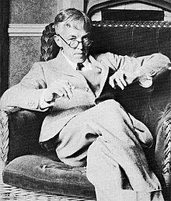
IDENTIFY THE PERSON

Slide 39
Answer :
G. H. Hardy
Godfrey Harold Hardy was an English mathematician, known for his achievements in number theory and mathematical analysis. In biology, he is known for the Hardy–Weinberg principle, a basic principle of population genetics.

Slide 40
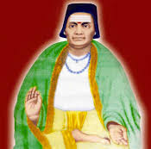
IDENTIFY THE PERSON

Slide 41
Answer :
Bhaskara
Bhaskara , was an Indian mathematician and astronomer. He was born in Bijapur in Karnataka. Bhāskara and his works represent a significant contribution to mathematical and astronomical knowledge in the 12th century

Slide 42
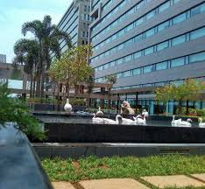
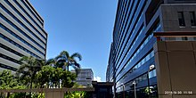
FINALLY …….
WHAT IS THE NAME OF THIS IT-PARK WHICH IS LOCATED AT TARAMANI ,CHENNAI ?

Slide 43
Answer :
Ramanujan
IT - Park
Ramanujan IT City is an information technology special economic zone situated in Chennai, India. Named after the Indian Mathematician Srinivas Ramanujan, it is a joint venture of Tata Realty and Infrastructure Limited, Indian Hotels Company Limited and Tamil Nadu Industrial Development Corporation.

Slide 44
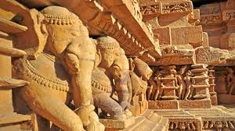
ROUND -4 History of mathEMATICS

Slide 45
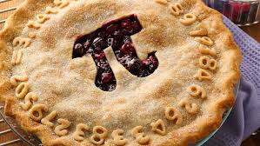
QUESTION 1)
When Pi Day is celebrated around the world?
ANSWER : 14 MARCH
THIS DATE IS 3 / 14 IN MM/DD FORMAT!
Pi = 3.14

Slide 46
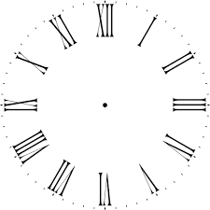
QUESTION 2)
The numerals used by today's mathematicians were developed in ...
ANSWER : Arabia not Rome

Slide 47
QUESTION 3)
WHO IS THE first mathematician of india ?

Slide 48
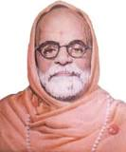
QUESTION 4)
Who invented vedic maths ?
Bharati Krishna Tirtha

Slide 49
QUESTION 5)
Who introduced the rules for solving quadratic equations?
Brahmagupta:
The great 7th Century Indian mathematician and astronomer Brahmagupta wrote some important works on both mathematics and astronomy.

Slide 50
ROUND 5

Slide 51
CALCULATE THE FOLLOWING :
9996
x 9997
-------------------------------------

Slide 52
ANSWER : 99930012
Simple trick …….
9996 - 4
x 9997 - 3
9993 0012

Slide 53
FIND THE ANSWER :
5¹⁶ x 16⁵

Slide 54
ANSWER : 160000000000000000
SOLUTION :
5¹⁶ x 16⁵
= 5¹⁶ x (2⁴)⁵
= 5¹⁶ x 2²⁰
= (5¹⁶ x 2¹⁶ )x 2⁴
= 10¹⁶ x 2⁴
= 16 x 10¹⁶
= 160000000000000000

Slide 55
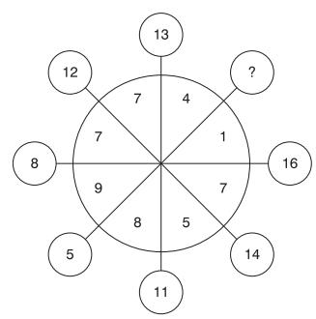
WHAT NUMBER SHOULD REPLACE THE QUESTION MARK ..

Slide 56
ANSWER : 17
It is the sum of the two digits (9 + 8) in the quadrant opposite.
12 = 7 + 5
8 = 1 + 7
5 = 4 + 1
11 = 7 + 4
14 = 7 + 7
16 = 7 + 9

Slide 57
There was one lake and a lotus. lotus doubles its size every day. After 30 days it has covered entire lake. How many days it takes to cover half of the lake?

Slide 58
ANSWER : On 29th day !
Since the size of lotus doubles every day ,
It must be half covering the lake in 29th day , then it completely occupies the lake in the 30th day !

Slide 59
FIND THE MISSING TERM !

Slide 60
ANSWER : 36
Multiply first two numbers in each row and subtract first number from the product to get third number in that row.
(2*11)-2 = 20 (4*9)-4 = 32 (7*8)-7 = 49 (4*10)-4 = 36
So, answer is 36.

Slide 61
SPECIAL QUESTION
Arrange all the numbers from 1 to 16 such that the sum of any two consecutive numbers always give a perfect square !

Slide 62
ANSWER :
8 , 1 , 15 , 10 , 6 , 3 , 13 , 12 , 4 , 5 , 11 , 14 , 2 , 7 , 9 , 16
OR
the reverse
16 , 9 , 7 , 2 , 14 , 11 , 5 , 4 , 12 , 13 , 3 , 6 , 10 , 15 , 1 , 8

Slide 63
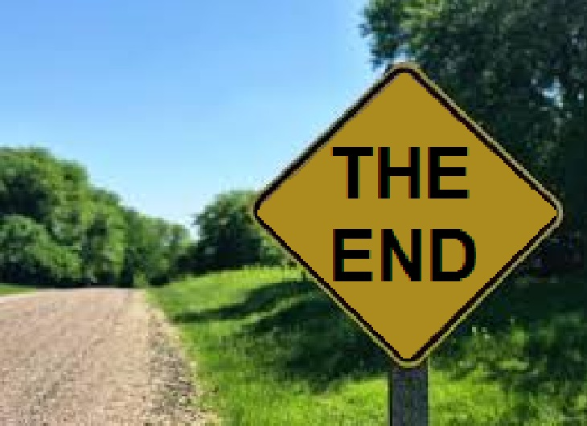
BY :
RAMANUJAM CLUB

